Slide 1
 | Lunchtime 1pm-1.25pm | After school 3.15pm – 4pm
Monday | Puzzle Club - Room 17 Eg: Word Search/ Count down/ /Time challenge. Drama Club 1.00 LIFE CLUB – faith & fun – Banklands chapel Youth Speaks - debating competition club Football all years – Astro (lunchtime duty staff) Handball - Sports Hall (Mr Owen) | Maths helps sessions ICT1 – yr 7-11 Online homework and general maths support Netball – Sports Hall (Miss Donaldson) Football years 7&8 – Astro (Mr Davidson)
Tuesday | Number Club - Room 17 (old pastoral room) Eg: Count down/ Dominos/Bingo / Sudoku. Year 7 reading club Fitness Suite all years – (Mrs Bell) Football all years – Astro (lunchtime duty staff) Girls Football – Sports Hall (Miss Donaldson) | Maths helps sessions ICT1 – yr 7-11 Online homework and general maths support Korean club – Miss Kim Rugby year 7 and 8 girls – Astro (Marni) Football years 9 & 10 – Sports Hall (Mr Davidson) Rugby year 7 and 8 boys – Astro (Mr Owen)
Wednesday | Time to Talk- Room 17 Meditation and reflection. Puzzle & games club – Room 28A Chess/ Backgammon plus a range of 3D puzzles Choir 10.50 Keyboard */Flute & Saxophone */Singing Lessons* (See Miss Bennet) Paired reading – B25 – selected students only Ignite Dance Academy – Sports Hall (Miss Zoe) Football all years – Astro (lunchtime duty staff) Fitness Suite all years – (Mrs Bell) | Maths helps sessions ICT1 – yr 7-11 Online homework and general maths support Band 3.20 – 4.00 Circuits all years – Fitness Suite (Mrs Bell) Cricket all years – Astro (Mr Owen) Badminton – Sports Hall (Mr Davidson)
Thursday | Girls Football – Sports Hall (Miss Donaldson) Debating Club- Room 17 (old pastoral room) different topic each week. E.g Xbox vs Play Station. Line Dancing 1.10 Guitar & Drum Lessons* (See Miss Bennet to pre-arrange) Fitness Suite all years - (Mr Owen) Badminton all years – Sports Hall (Mr Davidson) Football all years – Astro (lunchtime duty staff)
Friday | Film Club- Room 17 Time to watch and listen/ then discuss hot topics. Code club – ICT 2 Basketball – Sports Hall (Mr Davidson) Football all years – Astro (lunchtime duty staff) | Table Tennis and Badminton – Sports Hall (Mrs Bell) Football after school – staff and year 11 – Astro (Mr Davidson and Miss Donaldson)

Slide 2
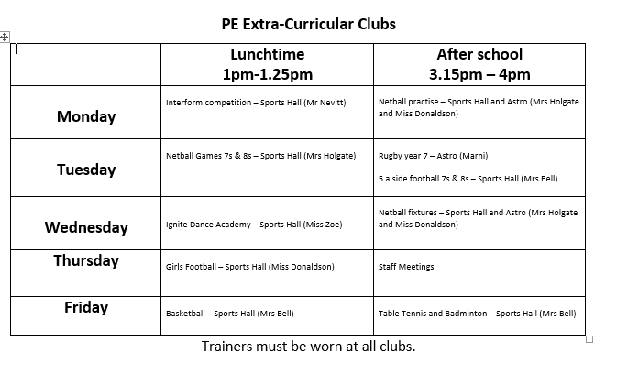

Slide 5
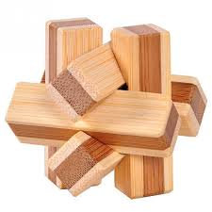
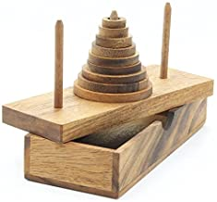
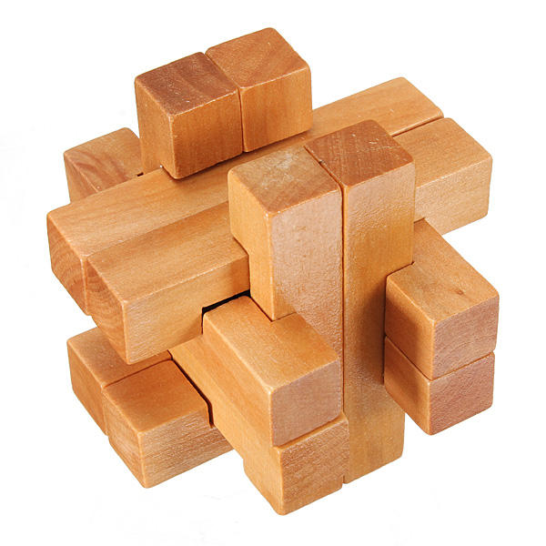
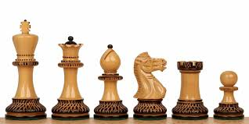
Puzzle and Games Club
Y7 and Y8
Wednesdays at lunch time Room 28A

Slide 10
