Slide 1
Chunking Technique
What is it?
It is a technique which can improve your memory
Chunking is the process of taking individual pieces of information (chunks) and grouping them into larger units
The power of chunking to help you learn
Your memory system becomes far more efficient
It helps you to recall the relevant information in your exams
Information becomes easier to retain and recall
It improves your creativity

Slide 2
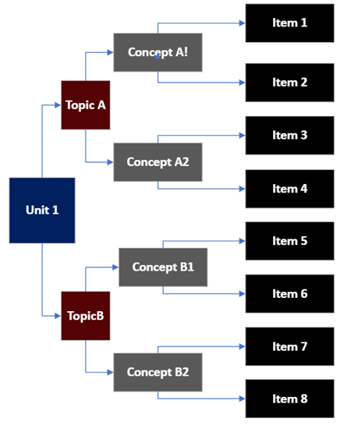
The Process
Break down larger amounts of information into smaller units.
Identify similarities or patterns.
Organise the information.
Group information into manageable units.
Use HEADINGS and TITLES for different sections.
Use TABLES to summarise DATA.
Use BULLET POINTS to summarise and CLARIFY IMPORTANT POINTS.
Combine quick ILLUSTRATIONS with TEXT to create VISUAL ASSOCIATIONS.

Slide 3
Principles
Focus – Chunking requires YOUR attention on the learning – Form Patterns
Understanding – You need to fully understand information before chunking material – Develop your tactics.
Context – You need to go beyond understanding the initial problem or concept and seeing when, where and how to apply it – Make connections.

