Slide 1
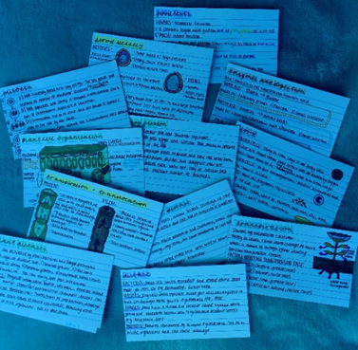
Using Flashcards - Information for Students
How do they help?
They engage you in ‘active recall’ – this creates stronger connections for your memory to recall information
They promote self-reflection – also known as metacognition, which firmly commits knowledge to your memory
Metacognition - When you make and use flashcards, you take control of your own learning. You have to decide what to put on each card, how often you’re going to use them, and then evaluate how well you know the information on each card
They can help you memorise facts quickly
Drilling - flashcards help you to practise the same information over and over again - and as we know, practice makes perfect!

Slide 2
Being Smart
Use spaced repetition - review your cards at specific, increasing intervals: for example, on Day 1, Day 2, Day 4, Day 8 and so on. Spaced repetition works because it activates your long-term memory, while leaving small breaks in between studying uses your short-term memory.
Make sure you have a ‘thinking pause’ after picking the card up and reading the question, then turn it over to read the information.
Once you get an answer right using your flashcard – DO NOT DISCARD IT! You need to keep repeating the question even if you get it right multiple times – otherwise it will ‘fall’ out of your memory.
As well as retrieving your knowledge, try writing the answer or definition in your own words and giving examples; this will help your learning and recall.
Try ‘interleaving’: once you have several decks of flashcards for different subjects and topics, try mixing them up. This will test your knowledge across subjects in a single session. Make sure you are confident enough to do this every so often.

Slide 3
How to make them...
1.Ensure that the flashcards have a question or key term on one side and the answer or definition on the other:
The flashcard must work the memory.
If flashcards only contain notes then no
2. Ensure the right questions and knowledge are on the cards.
3. Keep information as short as possible.
4.Write clearly. You should be able to read what you wrote at a very quick glance.
5.Use different coloured cards or pens to categorise your flashcards. For example, use a different colour for each subject or topic. This can help your brain to categorise
6.Make your flashcards as soon as you’ve learnt the topic in class.

Slide 4
Using Flashcards
Using flashcards is a repetition strategy
They are a simple ‘cue’ on the front and an ‘answer’ on the back.
Flashcards engage “active recall”
Studies have found that it’s more effective to review a whole stack of cards in one sitting rather than to carry them around with you and glance at them every so often!

Slide 5
Using a system...
The Leitner system is a well-known and very effective method of using flashcards. It’s a form of spaced repetition that helps you study the cards you don’t know more often than the cards you already know well.
They engage you in ‘active recall’ – this creates stronger connections for your memory to recall information
They promote self-reflection – also known as metacognition, which firmly commits knowledge to your memory
Metacognition - When you make and use flashcards, you take control of your own learning. You have to decide what to put on each card, how often you’re going to use them, and then evaluate how well you know the information on each card
They can help you memorise facts quickly
Drilling - flashcards help you to practise the same information over and over again - and as we know, practice makes perfect
All flashcards start off in box/stack 1.
The key is that the cards you know less well are reviewed more frequently than the cards in the higher boxes.
You now must choose the frequency at which you review each box. For example - Box 1: Every day, Box 2: Every 2 days, Box 3: Every 3 days, Box 4: Every 4 days

