Slide 1
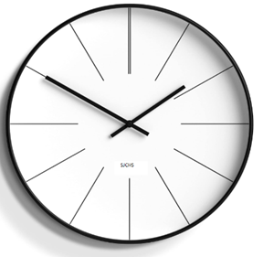
Spacing and Timing of Revision
What is it?
Spacing is a revision technique which is all about spacing out your revision, so you don’t get swamped and overwhelmed.
It means introducing time intervals into your revision sessions, as well as spacing out the days which you use to revise for topics.
To commit something to memory, it takes time and repetition.

Slide 2
How can it help you?
Doing something little and often – spacing – beats doing it at once, or cramming.
The time in between revision allows you to forget and re-learn the information, which cements it in your long-term memory.
It cements information into your long-term memory.
We can learn more information over time than in one longer session.
It helps you revise more efficiently.
Did you know? The brain requires a physical “prompt” in order to keep something in long-term memory. Otherwise, it is designed to let it go.

Slide 3
Top Tips for time!
Know what your revision goals are and set aside blocks of time.
Don’t work too much – work smarter, not harder.
Establish good habits and a structured revision routine.
Don’t procrastinate- don’t waste precious time worrying or thinking about what to do –just do it!
Review your work – prompt your brain with short review exercises.

Slide 4
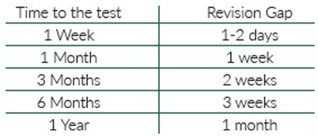
Optimum Spacing
Research suggests there is an ‘optimal gap’ between revision sessions so you can retain the information
If the test is in a month, you should review the information around once a week; if the test is in a week, create time once a day.
To commit something to memory, it takes time and repetition.

Slide 6
Create the perfect revision plan
1.Organisation: determine where you need to focus your time – e.g., which subjects, topics, what you know, what you struggle with etc.
2.Planning: map out what you are going to revise and when. Use a timetable or revision planner to do this. Choose a mixture of a subject’s topics to focus on each day to make sure you are spacing them out.
3.Review: build in different revision techniques to help you do some quick 5–10-minute reviews of your topics throughout your revision plan - e.g., reading through notes, highlighting information, making post-it notes.
4.Transformation task: these are 30-minute activities to help you take in information - e.g., writing summary sheets, flashcards or mind maps for topics.
5.Practice testing: test yourself on the area that you have reviewed, such as with quizzes or by testing yourself with a friend.
6.Exam questions: complete an exam question or questions on the area you have reviewed and mark this yourself, using a mark scheme.
Five hours of time, spent in smaller chunks and spaced periodically, is a far more effective way to learn something than five hours spent the night before.

